Slide 1
Keeping Integration Sane with NServiceBus
Jimmy bogard
http://jimmybogard.lostechies.com
@jbogard

Slide 2
Why do we integrate?

Slide 3
How do we integrate?

Slide 4
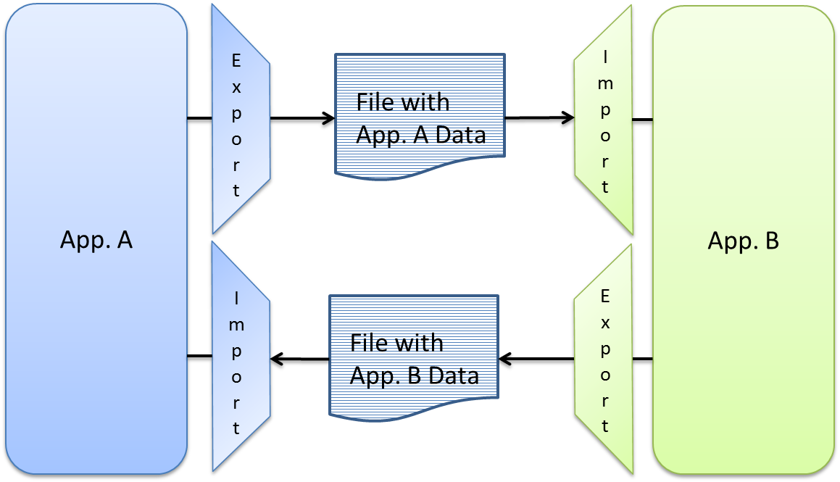
Files

Slide 5
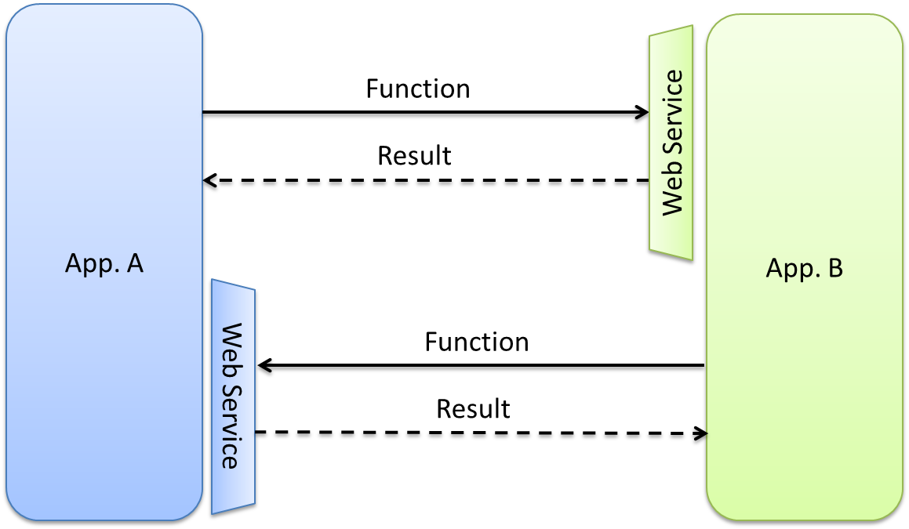
Web Services

Slide 6
Why do integrations suck?
Notes:
- They fail
- They assume that the network is up
- They assume that the network is fast
- They time out
- The other side goes down
- No transactions
- Often no way to recover from failure!

Slide 7
Make it suck less
(Calling web services)

Slide 8
Make it suck less
(Consuming files)

Slide 9
Make it suck less
(Producing files)

